Slide 1


LET'S GET STARTED!
Are you ready?

Slide 2
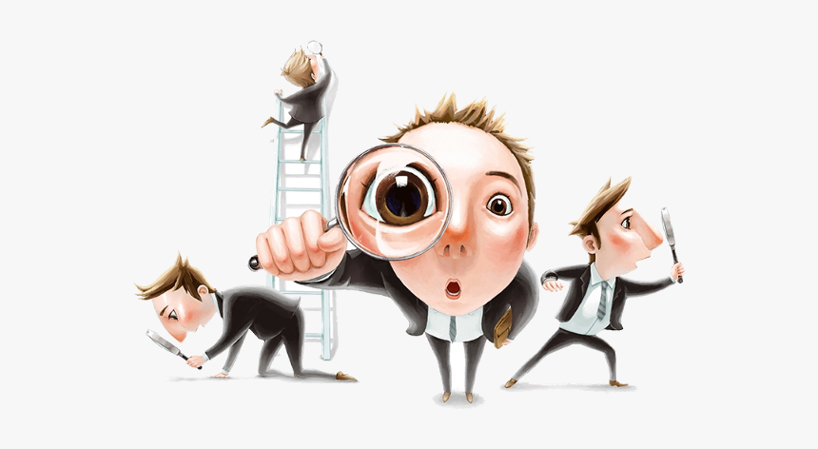

MODELS OF CONSUMER BEHAVIOUR

Slide 3
MODELS OF CONSUMER BEHAVIOUR
  Engel-Kollat-Blackwell (EKB) Model
  Howard Sheth Model
  The Fishbein Model
  Black Box Model of Consumer Behavior
  Theory of reasoned action

Slide 4
Engel-Kollat-Blackwell (EKB) Model
  Problem Recognition: The process begins when consumers perceive a need or a problem that needs to be solved. This could be triggered by internal factors (such as hunger or thirst) or external factors (such as advertising or recommendations from friends).
  Information Search: Once consumers recognize a problem, they actively seek information to help them make a decision. This information can be gathered from various sources, including personal experiences, word-of-mouth recommendations, advertisements, and online reviews.

Slide 5
Engel-Kollat-Blackwell (EKB) Model
3. Evaluation of Alternatives: After gathering information,
consumers evaluate the available options based on various criteria
such as price, quality, brand reputation, and features. They
compare the different alternatives to determine which one best
meets their needs and preferences.
4. Purchase Decision: Once consumers have evaluated the
alternatives, they make a decision to purchase a particular product
or service. This decision is influenced by factors such as the
perceived value of the product, affordability, and availability.

Slide 6
Engel-Kollat-Blackwell (EKB) Model
5. Post-Purchase Evaluation: After making a purchase, consumers evaluate their decision and the product's performance. If the product meets or exceeds their expectations, they are likely to experience satisfaction and may become repeat customers. However, if the product fails to meet their expectations, they may experience dissatisfaction and may not purchase from the same brand in the future.

Slide 7
Black Box Model of Consumer Behavior
"The Black Box model, sometimes called the Stimulus-Response model, says that customers are individual thinkers that process internal and external stimuli to make purchase decisions.
The black box model focuses on the consumer as a thinker and problem solver. It suggests that consumers respond to a range of external and internal factors when deciding whether or not to buy

Slide 8
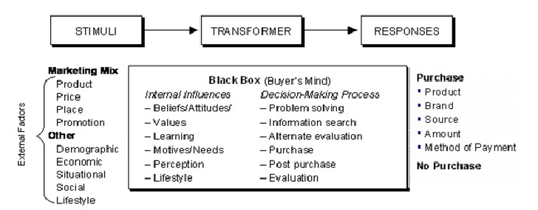
Black Box Model of Consumer Behavior

Slide 9
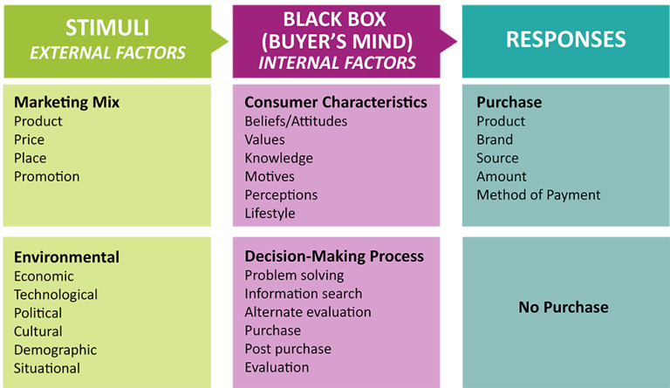

Slide 10
As illustrated in the figure in the previous slide, the external stimuli that consumers respond to include the marketing mix and other environmental factors in the market. The marketing mix (the four Ps) represents a set of stimuli that are planned and created by the company. The environmental stimuli are supplied by the economic, political, and cultural circumstances of a society. Together these factors represent external circumstances that help shape consumer choices.
The internal factors affecting consumer decisions are described as the “black box.” This “box” contains a variety of factors that exist inside the person’s mind. These include characteristics of the consumer, such as their beliefs, values, motivation, lifestyle, and so forth. The decision-making process is also part of the black box, as consumers come to recognize they have a problem they need to solve and consider how a purchasing decision may solve the problem. As a consumer responds to external stimuli, their “black box” process choices based on internal factors and determine the consumer’s response–whether to purchase or not to purchase.
Like the economic man model, this model also assumes that regardless of what happens inside the black box (the consumer’s mind), the consumer’ response is a result of a conscious, rational decision process. Many marketers are skeptical of this assumption and think that consumers are often tempted to make irrational or emotional buying decisions. In fact, marketers understand that consumers’ irrationality and emotion are often what make them susceptible to marketing stimuli in the first place.
For this reason, consumer purchasing behavior is considered by many to be a mystery or “black box.” When people themselves don’t fully understand what drives their choices, the exchange process can be unpredictable and difficult for marketers to understand.

Slide 11
Howard Sheth Model
The Howard Sheth model of consumer behavior posits that the buyer’s journey is a highly rational and methodical decision-making process. In this model, customers put on a “problem-solving” hat every step of the way — with different variables influencing the course of the journey.

Slide 12
Howard Sheth Model
"According to this model, there are three successive levels of decision-making:
  Extensive Problem-Solving: In this stage, customers knows nothing about the product they’re seeking or the brands that are available to them. They’re in active problem-solving mode to find a suitable product.
  Limited Problem-Solving: Now that customers have more information, they slow down and begin comparing their choices.
  Habitual Response Behavior: Customers are fully aware of all the choices they have and know which brands they prefer. Thus, every time they make a purchase, they know where to go."

Slide 21


THANK YOU!
Have a great day ahead.

